Slide 1
GestureBot Practical utilization of gesture recognition in motion-controlled robotics
Group 3:
Maximilian Eckstein, Cornelius Brandt, Harshal Ghadge, Fynn Schilke, Bjørn Sødal

Slide 2
Project idea
The problem we are solving:
controlling through joystick is not very intuitive
joystick control can be very unprecise (especially robotic arms)
Project goals:
Controlling the robots driving direction and speed
Controlling the arm
be actually able to pick something up (e.g. trash)
3D projection of hand movement to the robot arm (optional)
User Interface (optional)
Obstacle/object detection – collision avoidance (LIDAR, camera) (optional)

Slide 3
Project scope (use-cases)
Trash Pickup
Robo wrestling
Bomb defusal
Expedition robot
Help for handicapped people (Assistance, Job opportunities)
Medical Robots
Teaching purposes

Slide 4
Problem solution proposal
Gesture recognition through MediaPipe, OpenCV in Python
Robot controlling trough ROS2 (publisher – subscriber architecture)
Split main task into smaller ones (gesture recognition, robot control, …)

Slide 5
Implementation plan
week # | Planned tasks description
Previous | Setup Robot
39 | Robot Arm Setup and Testing
40 | Gestures mapped and recognized
41 | Prototype implementation only for driving
42 | DEMO
43 | Refinement and robot arm implementation
44 | Use case implementation
45 | Use case implementation
46-47 | Project completion

Slide 6
System overview
PC with webcam
Raspberry pi camera (for robot view)
Turtlebot controlled by raspberry pi
WiFi connection
All computation is done on the laptop → robot just receives and sends signals

Slide 7
Robot platform
Turtlebot 3 Waffle Pi
Dimensions: 281mm x 306mm x 141mm
max. velocity: 0.26m/s
max. rotational velocity: 1.82 rad/s
expected run time (battery time): 2h
Sensors:
360° Lidar
Raspberry Pi camera
IMU (3-axis gyroscope and accelerometer)
Open Manipulator-X Arm(4 DOF)
Computer: Raspberry PI 4

Slide 8
Gesture recognition approach
Predefined gestures
Map gestures to robotic movements
If possible: Usage of both hands → one for driving one for the arm
MediaPipe and OpenCV to recognize gestures
Recognized gestures are turned into computable signals

Slide 9
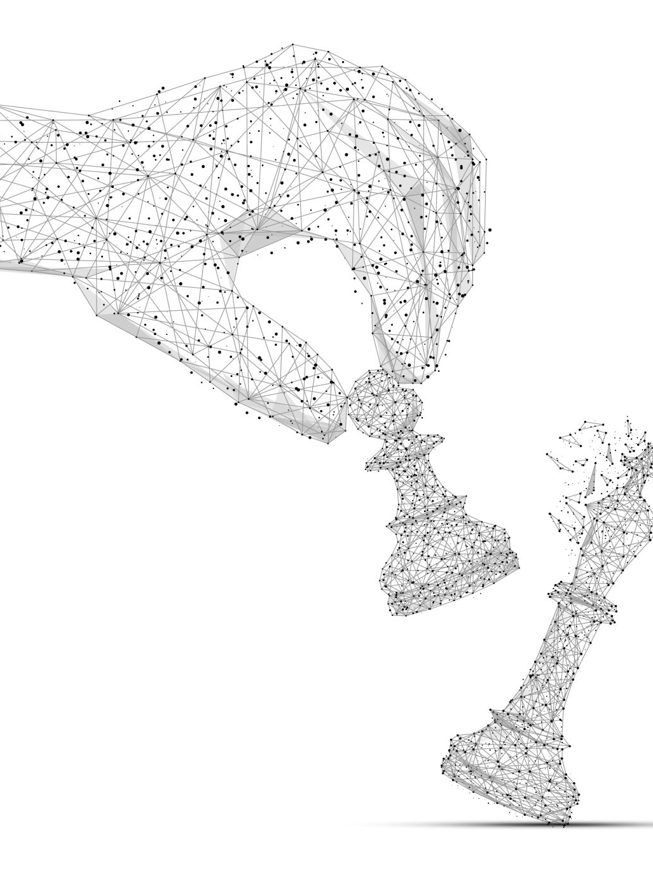
Challenges & Risks
Inconsistent gesture recognition
3d mapping of the hand in order to control arm might be not possible
Signal transmission problems
Malfunctions
Limited computing power on raspberry pi

Slide 10

Repository & Collaboration Plan
Version control via GitHub: https://github.com/corneliusbrandt/MV_Final_Project
Team is divided and works on the following topics:
Robot controls and simulation (ROS)
Gesture recognition
Object detection (Robot Camera)
(User Interface if time is left)

Slide 11
References
ROS 2 Humble doc: https://docs.ros.org/en/humble/index.html
MoveIT doc: https://moveit.picknik.ai/main/index.html
OpenCV doc: https://docs.opencv.org/4.x/index.html
MediaPipe doc: https://ai.google.dev/edge/mediapipe/solutions/guide?hl=de
H. Karam and J. Tanaka, "Finger click detection using a depth camera" in Proceedings of the AHFE 2015, 2015.
Turtlebot doc: https://emanual.robotis.com/docs/en/platform/turtlebot3/overview

